Slide 1
How to install Java & Java Development Kit (JDK)
Install java & java jdk 8
Open control system > Advanced system settings > environment variables
Under system variables, add {Variable: JAVA_HOME, Value: C:\Program Files\Java\jdk1.8.2_202}
Under system variables, edit ‘Path’, > New > %JAVA_HOME%\bin
Check version by run java –version & javac –version on cmd
How to install Hadoop
Install Hadoop from https://hadoop.apache.org/releases.html
Download the latest binary download https://dlcdn.apache.org/hadoop/common/hadoop-3.4.1/hadoop-3.4.1.tar.gz
Win + R > type ‘control system’ > Advanced system settings > Environment Variables… >
Under system variables, add {Variable: HADOOP_HOME, Value: C:\Hadoop}
Under system variables, edit ‘Path’ > New > %HADOOP_HOME%\bin
Add a another one, C:\hadoop\sbin
Create a new folder on C: named ‘hadoop’ and paste all document downloaded in step 2
Check version by run hadoop version in cmd
Run on Cmd
Hadoop version
Java –version
Javac –version

Slide 2
How to Run hdp-sandbox using Docker
Download docker from https://www.docker.com/products/docker-desktop/
Run docker pull hortonworks/sandbox-hdp:2.6.5 on terminal
Run docker run -d --name hdp-sandbox \ --hostname sandbox-hdp.hortonworks.com \ --privileged \ -p 8080:8080 -p 2222:22 \ -p 80:80 -p 2181:2181 -p 8042:8042 -p 7077:7077 -p 8888:8888 \ -p 50070:50070 -p 9000:9000 -p 10000:10000 \ -p 9995:9995 -p 8020:8020 \ hortonworks/sandbox-hdp:2.6.5
df
How to install Spark
Make sure you have Java JDK, Python, Hadoop
Download spark from https://spark.apache.org/downloads.html
Or can download straight from this link https://dlcdn.apache.org/spark/spark-3.5.5/spark-3.5.5-bin-hadoop3.tgz
9995 => Zeppelin
8080 => Ambari Dashboard
8042 => Hadoop
15070 => Hadoop

Slide 3
Configure PuTTy for Docker
Make sure container run using docker ps
Get host port using docker port hdp-sandbox 22
Hostname: localhost / 127.0.0.1
Port 2222
Connection type: SSH
Give name under saved session
Run Docker on VS Code
Run HDP on Docker
Run docker exec –it hdp-sandbox /bin/bash on cmd
Run Hive on VS Code
Make sure Hive is active on Ambari
Make sure port is active and connected by running: ssh –L 10000:localhost:10000 maria_dev@127.0.0.1 –p 2222

Slide 4
When should you consider using Hadoop
You have a very large dataset with size at least 10GB, if less than that, using Python and SQL is enough.
To get Docker IP Address using cmd, run:
docker inspect -f '{{range .NetworkSettings.Networks}}{{.IPAddress}}{{end}}' hdp-sandbox

Slide 5
Hadoop
-Ecosystem-
Hadoop Distributed File System (HDFS)
-Store File-
Apache Pig
Apache Hive
-Query Data-
Sqoop
Apache Spark
-Process Data-
Apache Zeppelin
MapReduce
-Process Data-
Apache Zeppelin

Slide 6
Run on Bash command / Linux shell command (Linux-based system)
Run on PowerShell command (Windows)

Slide 7
To see file save in local (docker) before copy to hdfs
Open docker > Containers > Click the container name > Files
Directory : home > maria_dev
To upload file to docker
On PowerShell run:
scp -P 2222 "D:/01. Education/…/fraud.csv" maria_dev@127.0.0.1:/home/maria_dev/
On Bash run:
hdfs dfs -mkdir -p /user/maria_dev/hazim
hdfs dfs -put /home/maria_dev/fraud.csv /user/maria_dev/hazim/
hdfs dfs -ls /user/maria_dev/hazim

Slide 8
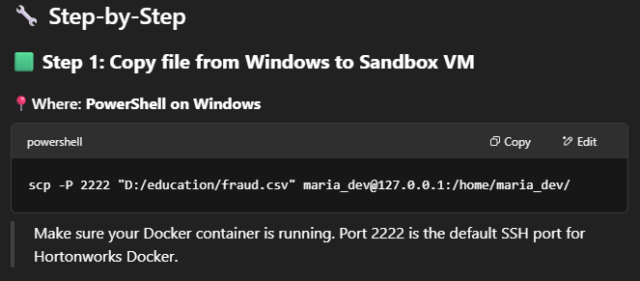
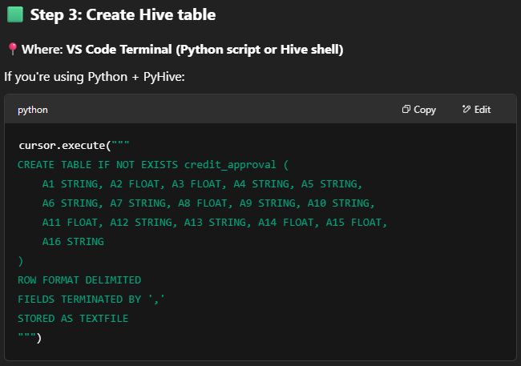
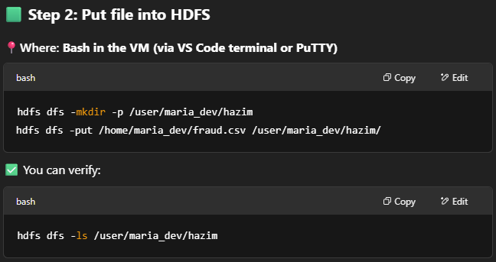
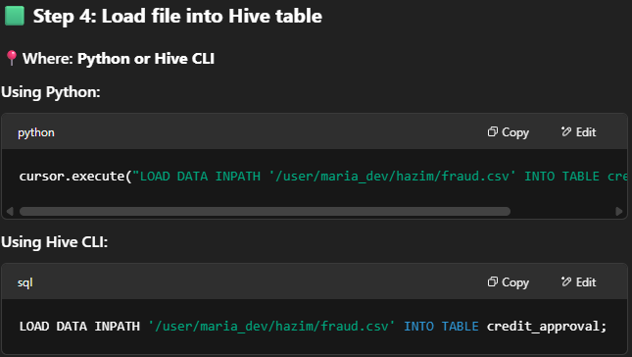
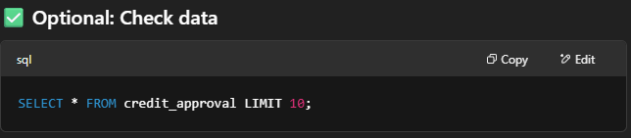

Slide 9
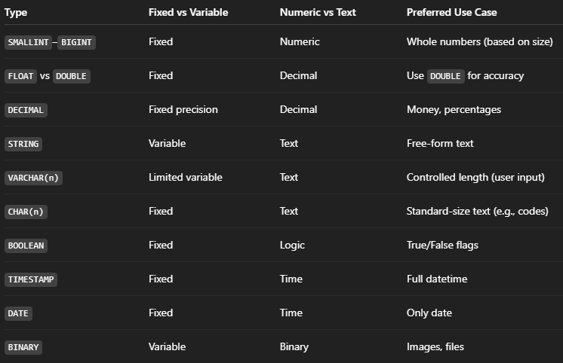
CREATE DATABASE <database name>;
DROP DATABASE <database name>;
SHOW DATABASES;
CREATE TABLE <database name>.<table name> (
<column name> <column type>, …
)
DROP TABLE <table name>;
When you use LOAD DATA INPATH, it’ll remove the data from hdfs and transfer it to Hive.
SMALLINT
INT
BIGINT
BOOLEAN
FLOAT
DOUBLE
STRING
BINARY
TIMESTAMP
DECIMAL
DATE
VARCHAR
CHAR

Slide 10
Upload data from local file into docker
docker cp "D:\01. Education\test.csv" hdp-sandbox:/home/maria_dev/test.csv

